Slide 1



DEPARTMENT OF COMPUTER SCIENCE & ENGINEERING
Domain Winter Winning Camp 2023
Subject Name: Database Management System
Day: 7
Topics Covered: Relational Algebra and Relational Calculus
DISCOVER . LEARN . EMPOWER

Slide 2
These points related to Day wise topic should be included :
Prerequisite of topic: Basic knowledge of Relational Algebra, Relational Calculus
Objective: To understand the relational database theory, and be able to write relational
algebra expressions for queries
Outcome : Implement relational Algebra and formulate real time queries on the data.

Slide 3
Topics covered
Relational Algebra
Cartesian product
Basic/Fundamental Operations
Derived Operations
Relational Calculus
TUPLE Relational Calculus
Domain Relational Calculus

Slide 4
Relational Algebra
Relational algebra is a procedural query language (that works on relational model) and based upon six fundamental operations:
Select, Project, Set-union, Set-difference, Cartesian Product, Rename
Several additional operations, built upon the fundamental operations:
set-intersection, natural join, division, assignment
Relational algebra operations can be extended in the form of grouping and aggregate functions.

Slide 5
Relational Algebra
It is a language in which we can ask questions (query) to a database.
It means that it tells what data to be retrieved and how to be retrieved.
The ﬁve fundamental operations in relational algebra are Selection, Projection, Cartesian product, Union, and Set difference, perform most of the data retrieval operations that industrial are interested in. In addition, there are also the Join, Intersection, and Division Operations, which can be expressed in terms of the ﬁve basic operations.
The Selection and Projection operations are Unary Operations, since they operate on one relation while the other operations work on pairs of relations and are therefore called Binary Operations.

Slide 6
Types of Operations
Basic/Fundamental Operations:
1. Select (σ) 2. Project (∏) 3. Union (∪) 4. Set Difference (-) 5. Cartesian product (X) 6. Rename (ρ)
Derived Operations:
1. Natural Join (⋈) 2. Left, Right, Full outer join (⟕, ⟖, ⟗) 3. Intersection (∩) 4. Division (÷)

Slide 7
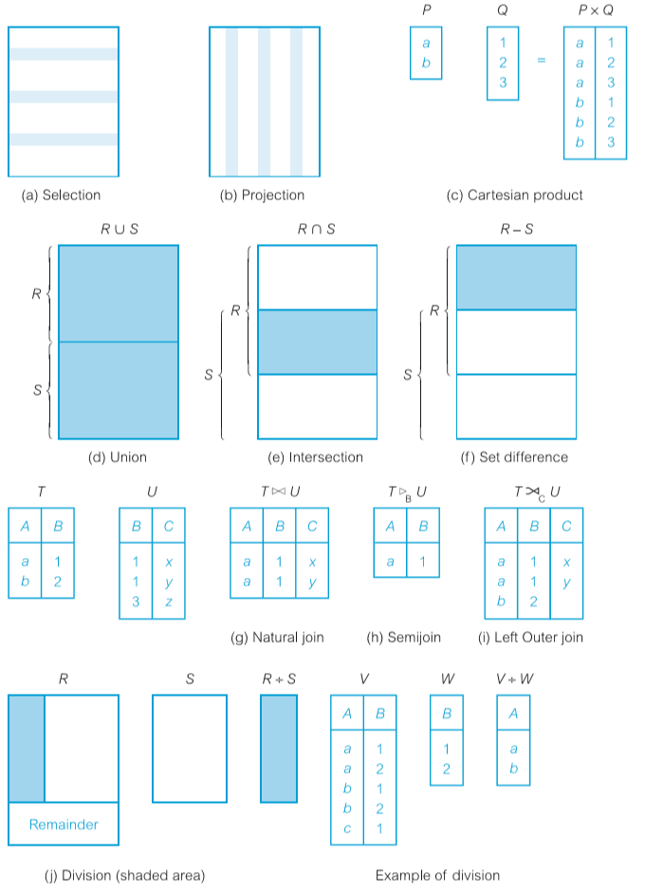
Relational Algebra Operations

Slide 8
Selection Operator
Select Operator (σ)
Select Operator is denoted by sigma (σ) and it is used to find the tuples (or rows) in a relation (or table) which satisfy the given condition.
It works on a single relation R and defines a relation that contains only those tuples of R that satisfied the specified condition(predicate).

Slide 9
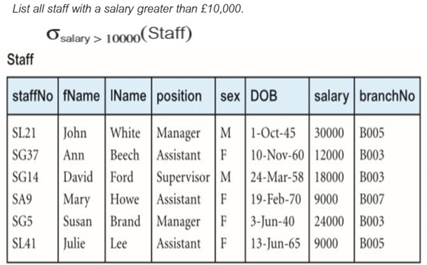
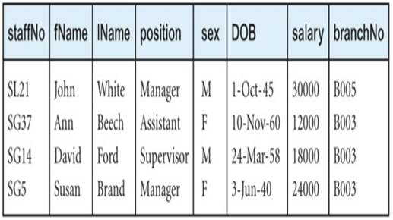
Example: Selection operator
Select * from Staff where salary >10000;
Output:-

Slide 10
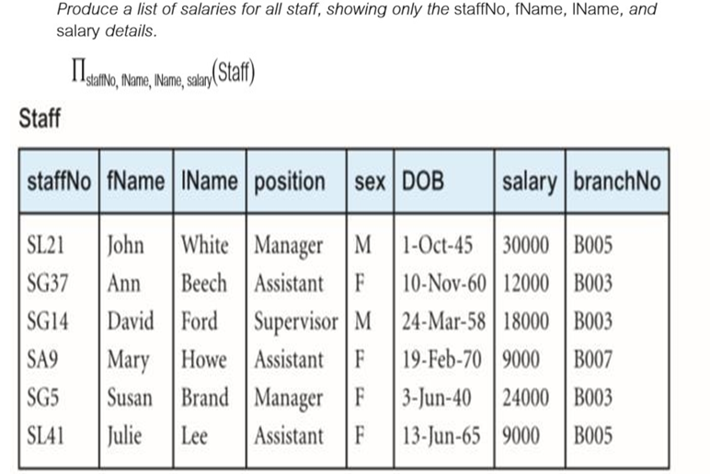
Projection Operator
Project operator is denoted by ∏ symbol and it is used to select desired columns (or attributes) from a table (or relation).
Project operator in relational algebra is similar to the select statement in sql.
Example:
Select staffNo, fName, IName, salary from Staff

Slide 11
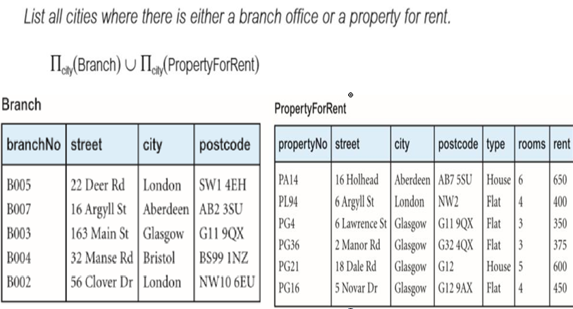
Union Operation
Union of two relation R and S defines a relation that contains all the tuples of R or S or both R and s, duplicate tuples being eliminated. R and S must be union compatible.
Union is possible if the schemas of two relations match.
Union operator is denoted by ∪ symbol and it is used to select all the rows (tuples) from two tables (relations).
Select City from Branch UNION Select City from PropertyForRent

Slide 12
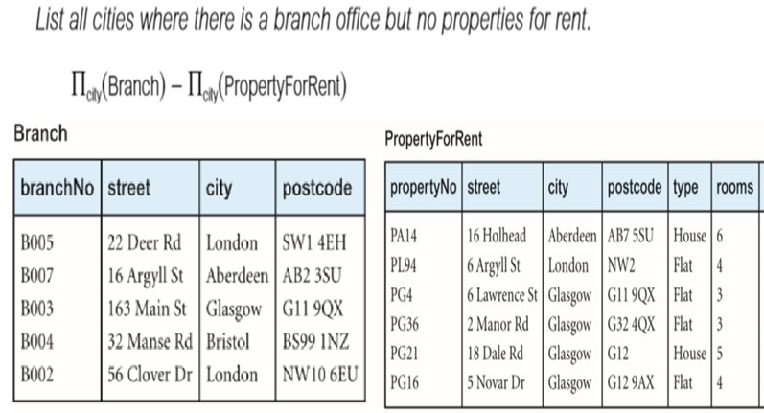
Set Difference
Set Difference is denoted by – symbol.
Lets say we have two relations R1 and R2 and we want to select all those tuples(rows) that are present in Relation R1 but not present in Relation R2, this can be done using Set difference R1 – R2.

Slide 13
Intersection
Intersection operator is denoted by ∩ symbol and it is used to select common rows (tuples) from two tables (relations).
Lets say we have two relations R1 and R2 both have same columns and we want to select all those tuples(rows) that are present in both the relations, then in that case we can apply intersection operation on these two relations R1 ∩ R2.
Note: Only those rows that are present in both the tables will appear in the result set.

Slide 14
Cartesian Product
Cartesian Product is denoted by X symbol.
Lets say we have two relations R1 and R2 then the cartesian product of these two relations (R1 X R2) would combine each tuple of first relation R1 with the each tuple of second relation R2.
It’s a concatenation of every tuple of relation R with every tuple of relation S.
It multiplies two relations to define another relation consisting of all possible pairs of tuples.

Slide 15
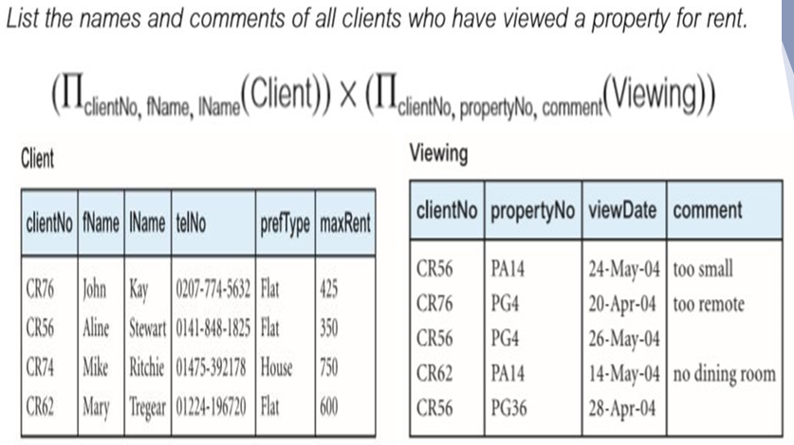
Example

Slide 16
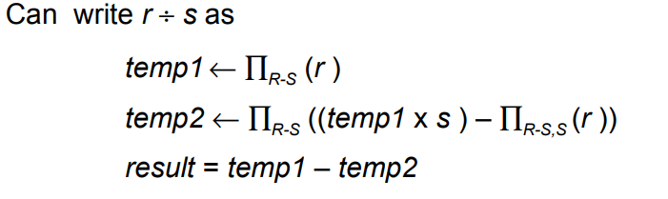
Division operation
The division operation (R/S) defines a relation over the attributes C that consist of the set of tuples from R that match the combination of every tuple in S.
Let R(A,B) and S(B) be two relations. Division should find all values of A in R that are connected with all values of B (in S). Think AB÷B= A.
So R÷S = πA(R)−πA(πA(R)×S−R)
Example:

Slide 17
Rename Operation
Allows us to name, and therefore to refer to, the results of relational-algebra expressions.
Allows us to refer to a relation by more than one name.
To rename STUDENT relation to STUDENT1, we can use rename operator like:
ρ(STUDENT1, STUDENT)
If you want to create a relation STUDENT_NAMES with ROLL_NO and NAME from STUDENT, it can be done using rename operator as:
ρ(STUDENT_NAMES, ∏_{(ROLL_NO, NAME)}(STUDENT))

Slide 18
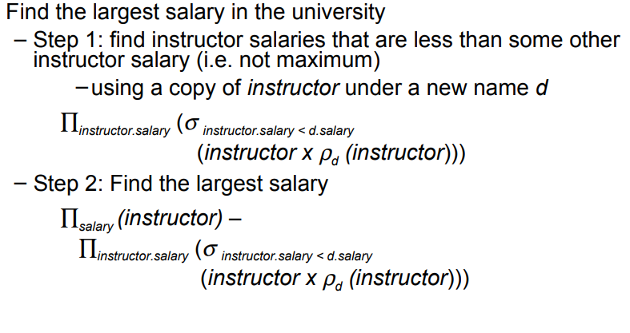
Example

Slide 19

Aggregate and Grouping Functions
Aggregation function takes a collection of values and returns a single value as a result.
avg: average value
min: minimum value
max: maximum value
sum: sum of values c
count: number of values
Aggregate operation in relational algebra:
Here E is any relational-algebra expression
– G1 , G2 …, Gn is a list of attributes on which to group (can be empty)
– Each Fi is an aggregate function
– Each Ai is an attribute name

Slide 20
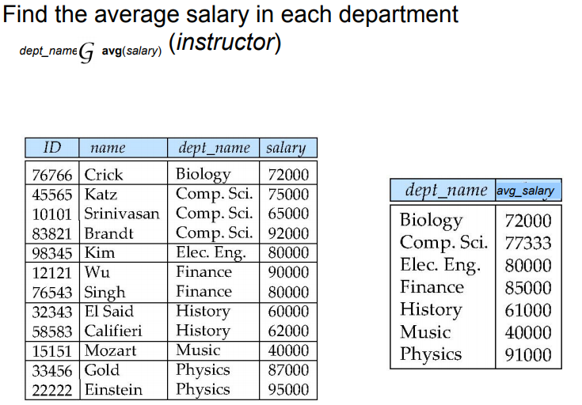
Example:

Slide 21
SQL and Relational algebra
a) select A1, A2, .. An
from r1, r2, …, rm
where P
is equivalent to the following expression in multiset relational algebra:
∏ A1, .., An (σ P (r1 x r2 x .. x rm))
b) select A1, A2, sum(A3)
from r1, r2, …, rm
where P
group by A1, A2
is equivalent to the following expression in multiset relational algebra:
A1, A2 sum(A3) (σ P (r1 x r2 x .. x rm)))

Slide 22
RELATIONAL CALCULUS
Relational Algebra is a PROCEDURAL LANGUAGE
we must explicitly provide a sequence of operations to generate a desired output result
Relational Calculus is a DECLARATIVE LANGUAGE
we specify what to retrieve, not how to retrieve it

Slide 23

TUPLE RELATIONAL CALCULUS
Query: {T|P(T)}
T is tuple variable
P(T) is a formula that describes T
Result: the set of all tuples t for which P(t) evaluates True.
Find all sailors with a rating above 7.

Slide 24
OPERATIONS in Tuple Relational Calculus
∧ - AND
∨ - OR
¬ - NOT
∃x – there exists x
∀x – for all x
Note: General power of 1st order predicate calculus – allow more flexible expression formats

Slide 25
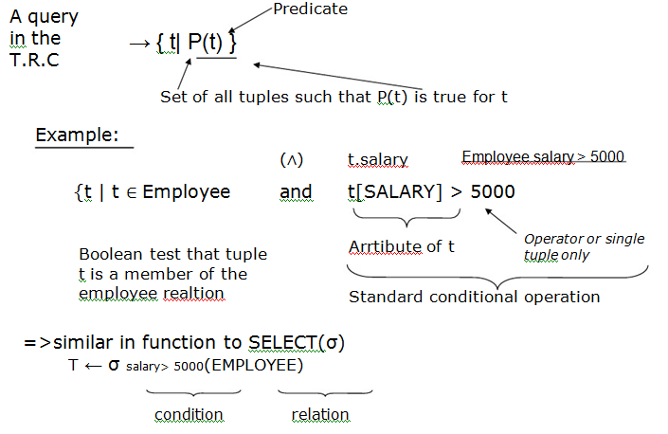
TUPLE RELATIONAL CALCULUS

Slide 26
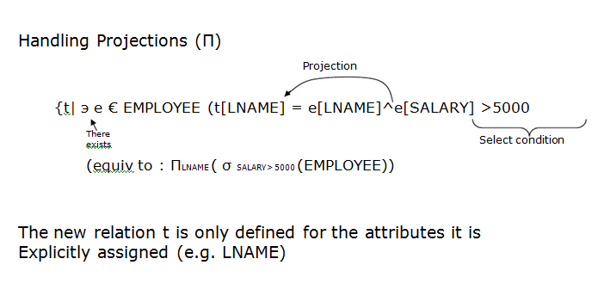
TUPLE RELATIONAL CALCULUS

Slide 27
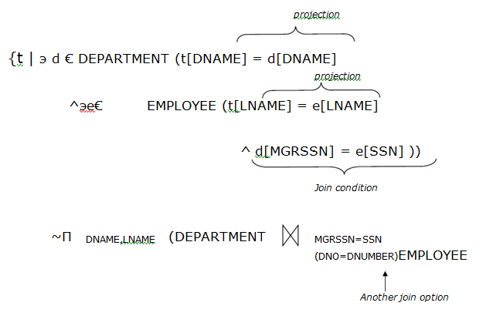
JOINS IN THE TUPLE RELATIONAL CALCULUS

Slide 28
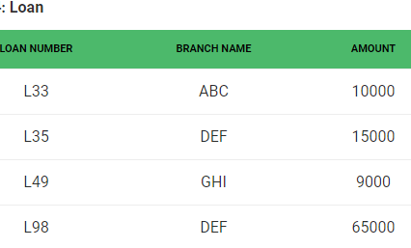
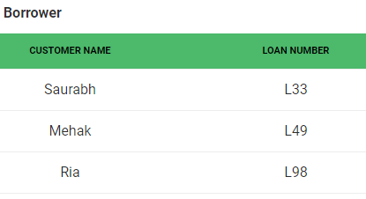
Examples
Consider relations for queries:
Relation 1:
Relation 2:

Slide 29
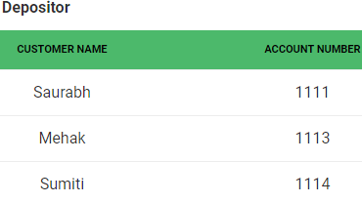
1. Find the loan number, branch, amount of loans of greater than or equal to 10000 amount
{t| t ∈ loan ∧ t[amount]>=10000}
2. Find the loan number for each loan of an amount greater or equal to 10000.
{t| ∃ s ∈ loan(t[loan number] = s[loan number] ∧ s[amount]>=10000)}
3. Find the names of all customers who have a loan and an account at the bank.
{t | ∃ s ∈ borrower( t[customer-name] = s[customer-name]) ∧ ∃ u ∈ depositor( t[customer-name] = u[customer-name])}
4. Find the names of all customers having a loan at the “ABC” branch.
{t | ∃ s ∈ borrower(t[customer-name] = s[customer-name] ∧ ∃ u ∈ loan(u[branch-name] = “ABC” ∧ u[loan-number] = s[loan-number]))}
Relation 3:

Slide 30
Domain Relational Calculus
• Query has the form:
{ <x1,x2….xn>| p(<x1,x2….xn>)}
• Domain Variable – ranges over the values in the domain of some attribute or is a constant
• Example: If the domain variable x1 maps to attribute - Name char(20) then x1 ranges over all strings that are 20 characters long
Not just the strings values in the relation’s attribute
Answer includes all tuples that make the formula p() true.

Slide 31
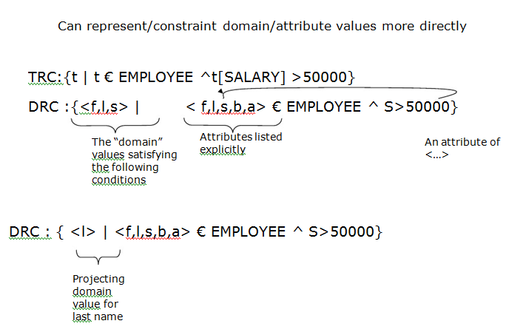
DOMAIN RELATIONAL CALCULUS

Slide 32
DRC Formulas
Atomic Formulas
<x1,x2,…xn>∈ Relation where Relation is a relation with n attributes
X operation Y
X operation constant
Where operation is an operator in the set { , = , ≤, ≥, ≠ }
• Recursive definition of a Formula:
An atomic formula
¬p, p∧q, p∨q, where p and q are formulas
∃X(p(X)), where variable X is free in p(X)
∀X(p(X)), where variable X is free in p(X)
The use of quantifiers ∃X and ∀X is said to bind X
A variable that is not bound is free.

Slide 33
Quantifiers: ∀x and ∃x
Variable x is said to be subordinate to the quantifier
You are restricting (or binding) the value of the variable x to set S
• The set S is known as the range of the quantifier
• ∀x predicate true for all elements in set S
• ∃x predicate true for at least 1 element in set S

Slide 34
Examples
1. Find the loan number, branch, amount of loans of greater than or equal to 100 amount.
{≺l, b, a≻ | ≺l, b, a≻ ∈ loan ∧ (a ≥ 100)}
2. Find the loan number for each loan of an amount greater or equal to 150.
{≺l≻ | ∃ b, a (≺l, b, a≻ ∈ loan ∧ (a ≥ 150)}
3. Find the names of all customers having a loan at the “Main” branch and find the loan amount .
{≺c, a≻ | ∃ l (≺c, l≻ ∈ borrower ∧ ∃ b (≺l, b, a≻ ∈ loan ∧ (b = “Main”)))}

Slide 35
Interview Questions
How Cartesian product works for operation on a given problem?
What is Relational Algebra?
Interpret ∏subject, author (Books)
How does Tuple-oriented relational calculus differ from domain-oriented relational calculus?
In the relational calculus, the variables are bounded with the help of what?
Why tuple relational calculus is known as non procedural?
The branch of calculus which is based on mathematical logic is classified as what?
Define Union All operator and Union.
How do you communicate with an RDBMS?

Slide 36
Practice Question
Consider the following schemas:
Suppliers(sid: integer, sname: string, address: string)
Parts(pid: integer, pname: string, color: string)
Catalog(sid: integer, pid: integer, cost: real)
State what the following queries compute:
Q1. Find the Supplier names of the suppliers who supply a red part that costs less than 100 dollars and a green part that costs less than 100 dollars.
Q2. Find the Supplier names of the suppliers who supply a red part that costs less than 100 dollars.
Q3. Find the Supplier names of the suppliers who supply a red part that costs less than 100 dollars and a green part that costs less than 100 dollars.

Slide 37
References
Codd, E.F. (June 1970). "A Relational Model of Data for Large Shared Data Banks". Communications of the ACM. 13 (6): 377–387. doi:10.1145/362384.362685.
C. J. Date (2011). SQL and Relational Theory: How to Write Accurate SQL Code. O'Reilly Media, Inc. pp. 133–135. ISBN 978-1-4493-1974-8.
https://en.wikipedia.org/wiki/Relational_algebra
https://phoalard.net/4/5117867/?var=2579905&ab2r=0&prfrev=false&rhd=false

Slide 38
Thank you

